Slide 1
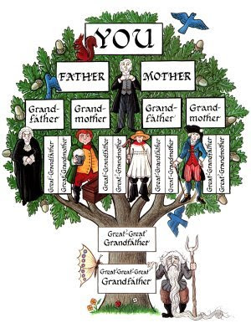
Equilibrio y desequilibrio
Balance and unbalance
1720, a man considered
lazy- Haragan
Godless- sin temor a Dios
with a reputation as the town troublemaker.- Buscapleitos
Alcoholic- alcoholico
viewed as having low moral character- De bajo caracter moral
married a woman who was much like himself- se caso con una mujer igual que el
six daughters and two sons- tuvieron seis hijas y dos hijos
www.corderoyleon.com

Slide 2
Equilibrio y desequilibrio
Balance and unbalance
Aquí está lo que el informe revea- llevó sobre los aproximadamente 1.200 descendientes de esta pareja que estaban vivos por 1874:
• 310 eran personas sin hogar.
• 160 eran prostitutas.
Here is what the report revea- led about the approximately 1,200 descendants of this couple who were alive by 1874:
• 310 were homeless.
• 160 were prostitutes.
www.corderoyleon.com
Notes:
In 1874 a member of the New York State Prison Board noticed that six members of the same family were incarcerated at the same time. The board did some research, looking back a few generations to try to find the original couple who initiated this tragic family legacy.
They traced the family line back to an ancestor born in 1720, a man considered lazy and godless with a reputation as the town troublemaker. He was also an alcoholic and viewed as having low moral character. To make matters worse, he married a woman who was much like himself, and together they had six daughters and two sons.

Slide 3
Equilibrio y desequilibrio
Balance and unbalance
180 sufrieron de abuso de alcohol
150 fueron criminales que pasaron tiempo en la prision, incluyendo siete por asesinato
• 180 suffered from drug or alcohol abuse.
• 150 were criminals who spent time in prison, including seven for murder.
www.corderoyleon.com

Slide 4
Equilibrio y desequilibrio
Balance and unbalance
El reporte encontro que el Estado de Nueva York gasto $1.5 millones una cifra alta en ese tiempo en cuidado de sus descendientes y ninguno hizo una aportacion valiosa para la sociedad
The report also found that the State of New York had spent $1.5 million—a shockingly high number at the time—to care for this line of descendants, and not one had made a significant contribution to society
www.corderoyleon.com

Slide 5
Equilibrio y desequilibrio
Balance and unbalance
Jonathan Edwards 1703.
Un hombre muy religioso
Vivio una vida con altos valores morales
Llego a ser un ministro un dedicado hombre de familia
A deeply religious man
he lived a life of strong moral values
became a minister and a dedicated family man.
www.corderoyleon.com

Slide 6
Equilibrio y desequilibrio
Balance and unbalance
Se caso con una mujer llamada Sarah que compartia los mismos valores morales
Tuvieron 11 hijos
Jonathan Edwards llego a ser presidente de la Universida Princeton
He married a deeply religious woman named Sarah who shared his values
they had 11 children
Jonathan Edwards became the president of Princeton University.
www.corderoyleon.com

Slide 7
Equilibrio y desequilibrio
Balance and unbalance
Esto fue lo que descubrieron los investigadores acerca de aproximadamente 1,400 descendientes de Jonathan y Sarah Edwards en 1874
Here is what researchers discovered about the approximately 1,400 descendants of Jonathan and Sarah Edwards by 1874:
www.corderoyleon.com

Slide 8
Equilibrio y desequilibrio
Balance and unbalance
13 fueron presidentes de colegios
65 fueron profesores de colegio
100 fueron abogados
32 fueron jueces estatales
85 fueron autores de libros clasicos
13 were college presidents.
65 were college professors.
100 were attorneys.
32 were state judges.
85 were authors of classic books.
www.corderoyleon.com

Slide 9
Equilibrio y desequilibrio
Balance and unbalance
66 fueron doctores
80 tuvieron puestos politicos incluyendo tres gobernadores estatales
3 fueron senadores estatales
1 llego a ser vicepresidente de los Estados Unidos
66 were physicians.
80 held political offices, including three state governors.
3 were state senators.
1 became vice president of the United States.
www.corderoyleon.com

Slide 10
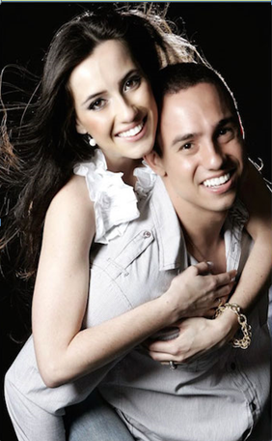
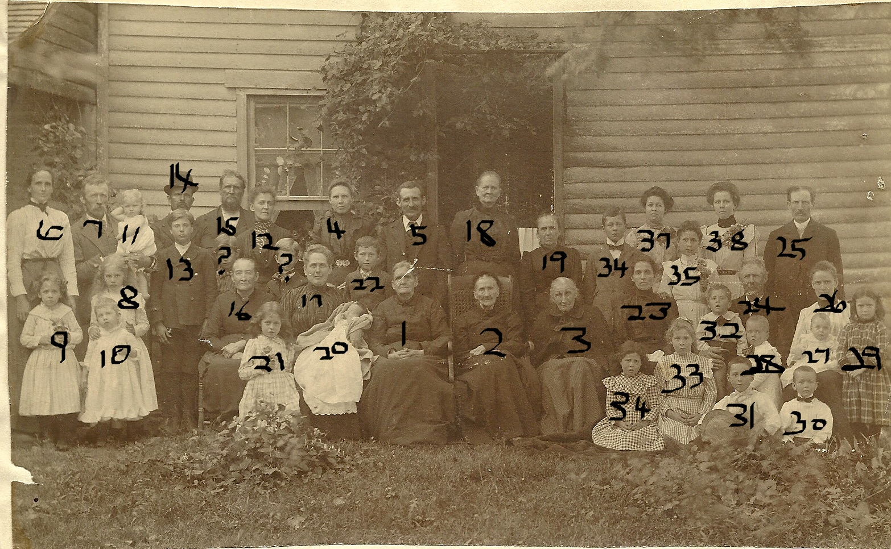
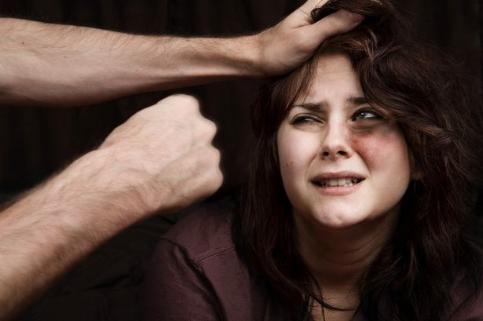
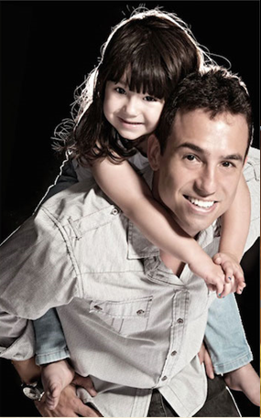
sssss
www.corderoyleon.com

